Slide 1
Inheritance

Slide 2
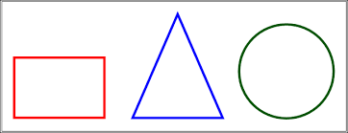
Motivations
Suppose you will define classes to model circles, rectangles, and triangles.
These classes have many common features (i.e., color, date created, filled or not filled, etc.). What is the best way to design these classes so to avoid redundancy?
*Note that, these classes have many uncommon features too (i.e., radius, length, height, etc.).

Slide 3

Motivations

Slide 4
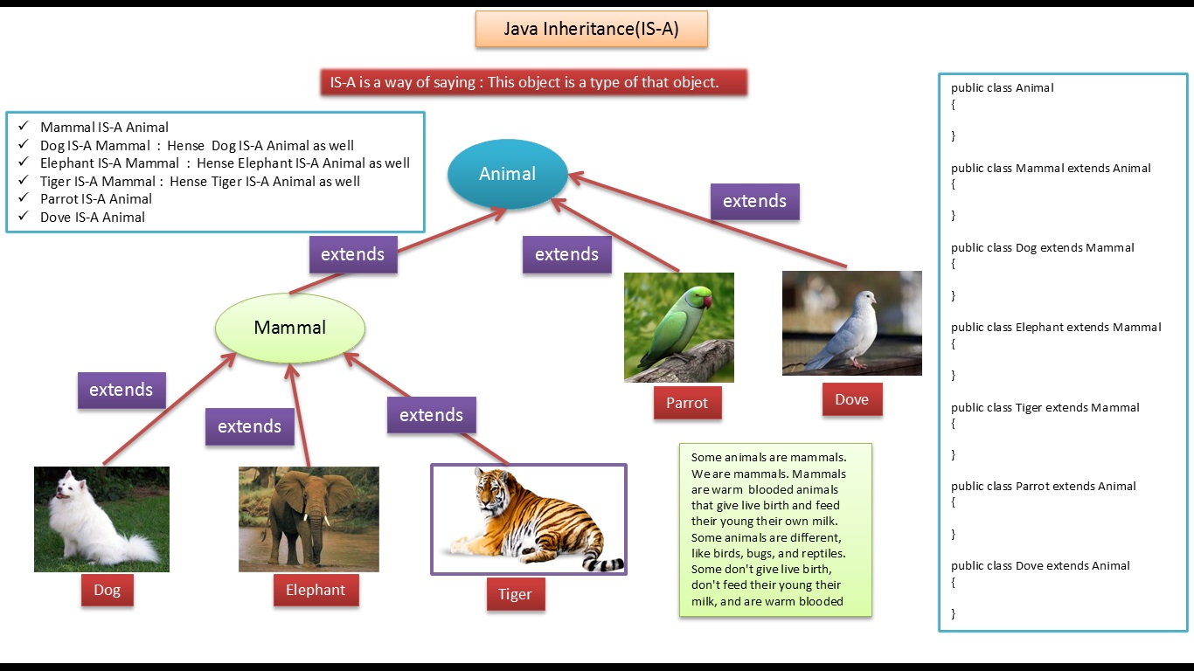
More examples

Slide 5
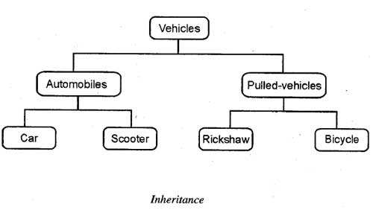
More examples

Slide 6
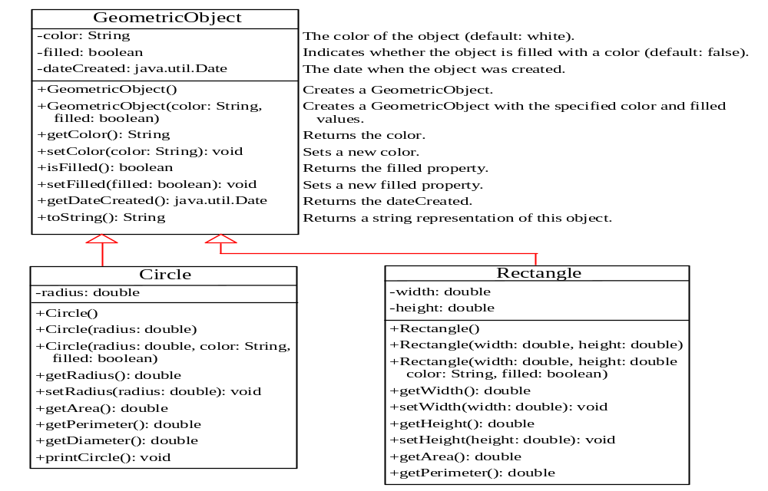
Superclasses and Subclasses

Slide 7
Are superclass’s Constructor Inherited?
No. They are not inherited.
They are invoked explicitly (using the super keyword) or implicitly.
A constructor is used to construct an instance of a class.
Unlike properties and methods, a superclass's constructors are not inherited in the subclass.
They can only be invoked from the subclasses' constructors, using the keyword super.
If the keyword super is not explicitly used, the superclass's no-arg constructor is automatically invoked.

Slide 8


Superclass’s Constructor Is Always Invoked
A constructor may invoke an overloaded constructor or its superclass’s constructor. If none of them is invoked explicitly, the compiler puts super() as the first statement in the constructor. For example,

Slide 9
Using the Keyword super
The keyword super refers to the superclass of the class in which super appears. This keyword can be used in two ways:
To call a superclass constructor
To call a superclass method

Slide 10
CAUTION
You must use the keyword super to call the superclass constructor. Invoking a superclass constructor’s name in a subclass causes a syntax error. Java requires that the statement that uses the keyword super appear first in the constructor.

